Slide 1
Travel Insurance Customers Travel Habits
Travel Assured

Slide 2
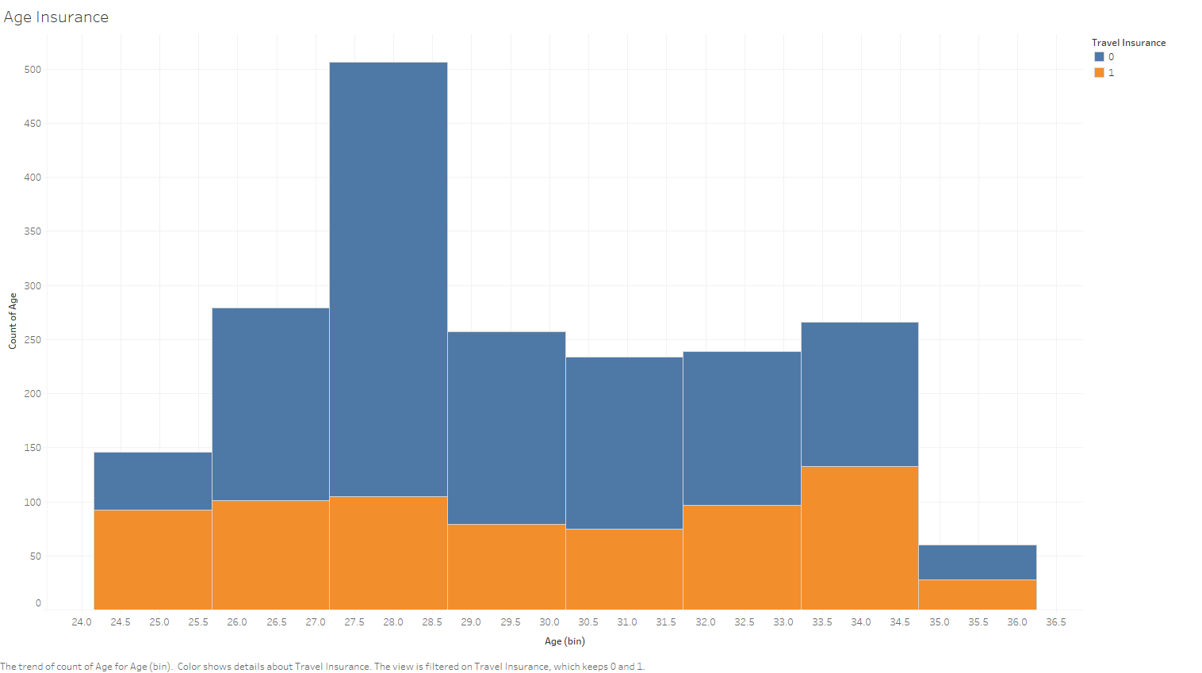
Differences between customers and non-customers
Notes:
It appears that 28 year olds are a key sector, but most choose to travel without insurance. Generally other age groups around half take insurance and half do not.

